Slide 1
Text2give
Donors
4:21 PM
Send

Slide 2
ACCOUNT REGISTRATION

Slide 3
(203) 872-9947
Your number here
First ensure that your phone is connected to wi-fi, or your mobile data is turned on.
Text “Register” to your church’s Text2Give number, listed above.
Click the link in the response.

Slide 4
Enter your contact information in the form.

Slide 5
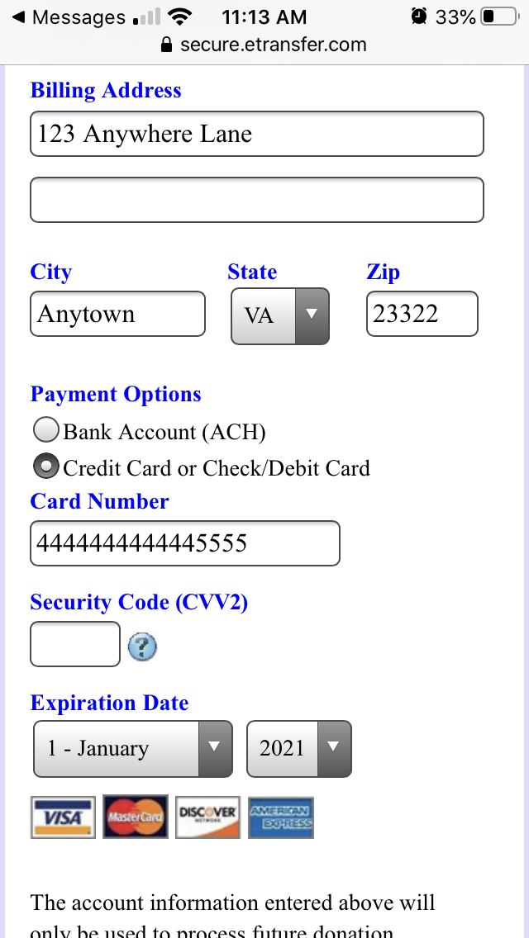
Select your preferred payment method.

Slide 6
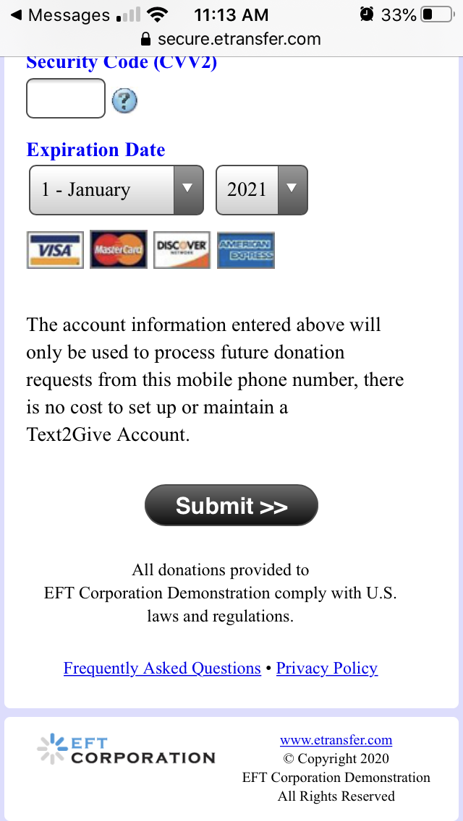
Submit your registration information.

Slide 7
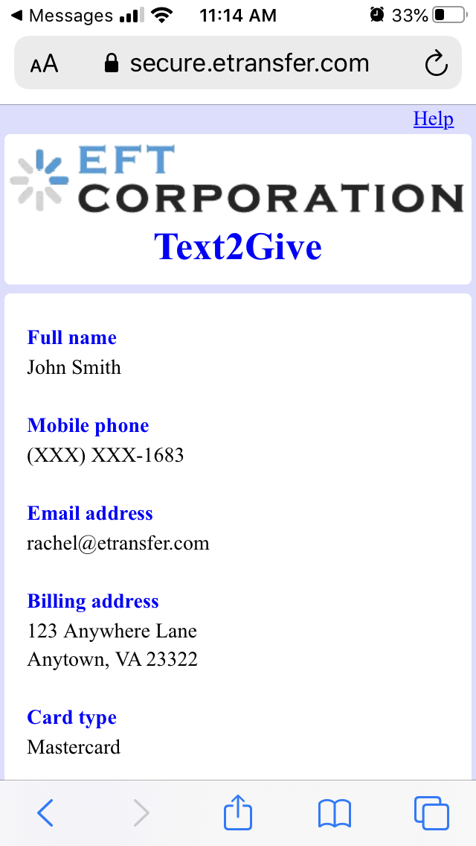
Review your information

Slide 8
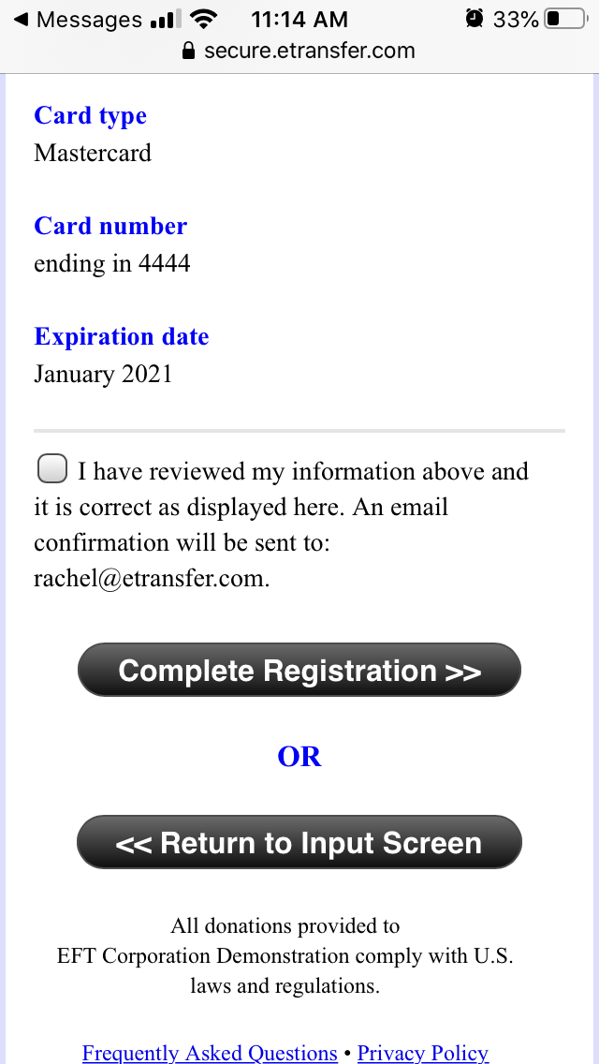
If necessary, select “Return to Input Screen” to make a correction.
Or, if everything is correct, select the box to confirm your information.
Select “Complete Registration”.

Slide 9
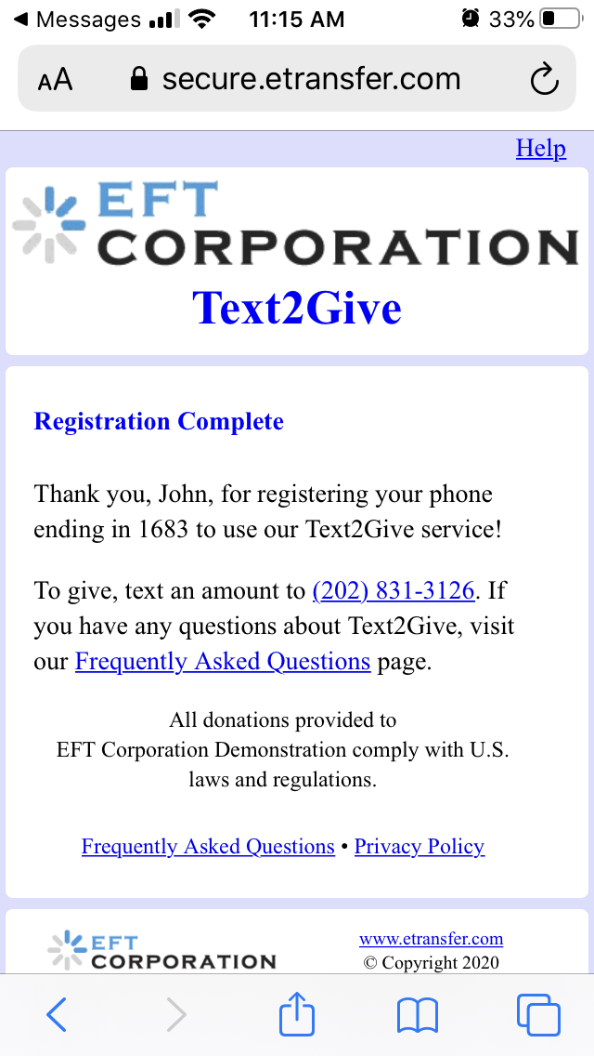
You will be shown the registration confirmation screen.
Your number here

Slide 10
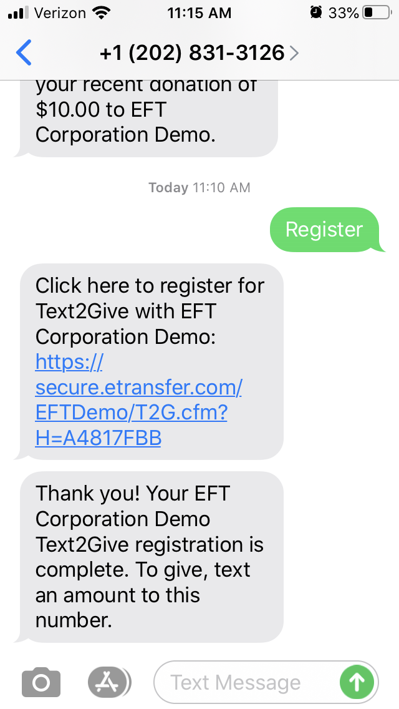
After your registration has been completed, you will receive a confirmation email.
You will also receive a confirmation text message as well.
Your number here

Slide 11
Now you are ready to make your first Text2Give gift!

Slide 12
Making a gift

Slide 13
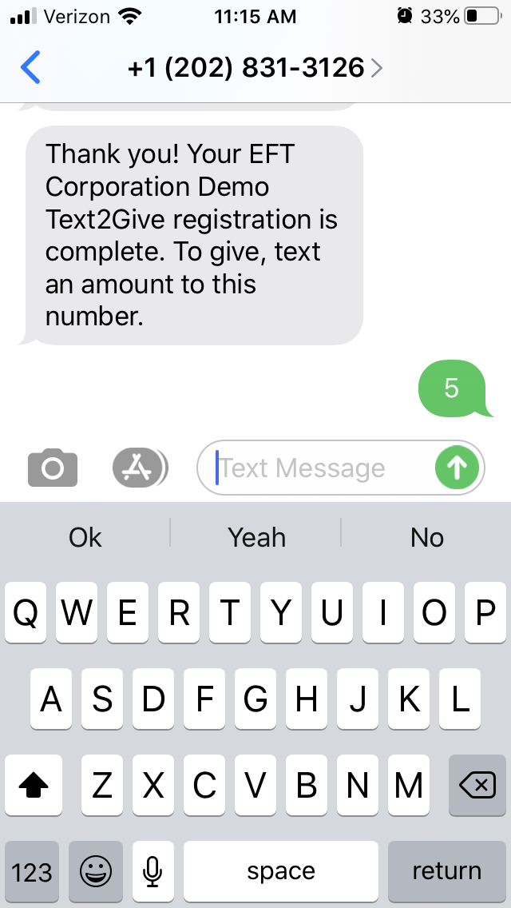
Your number here
Text an amount to:
(203) 872-9947
The payment method entered during the registration process will be charged for your gift.

Slide 14
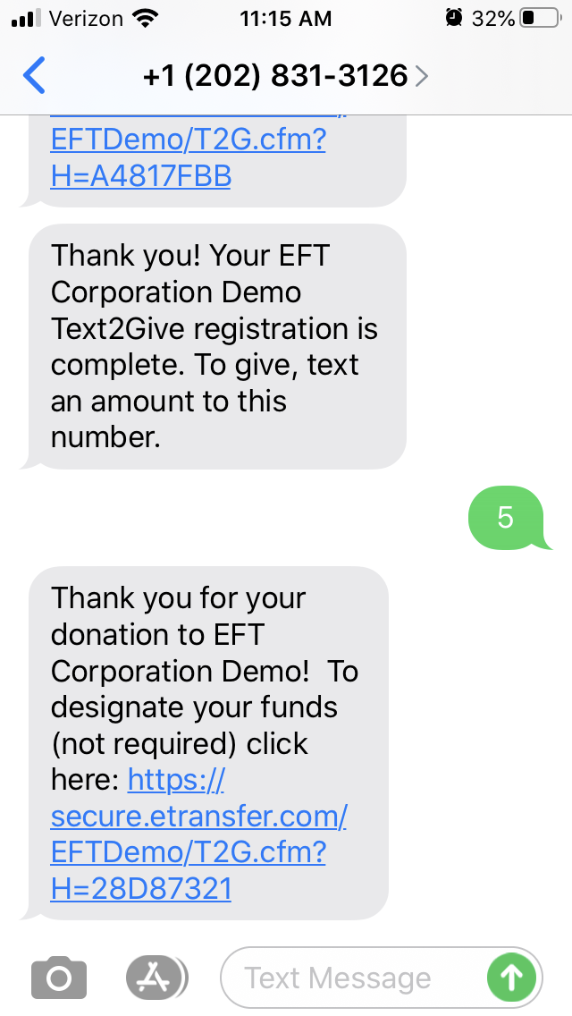
Your number here
You will receive a confirmation text message with a link allowing you to designate your gift.
If you choose not to designate your gift, the funds will be designated to the Payment toward Pledge fund.

Slide 15
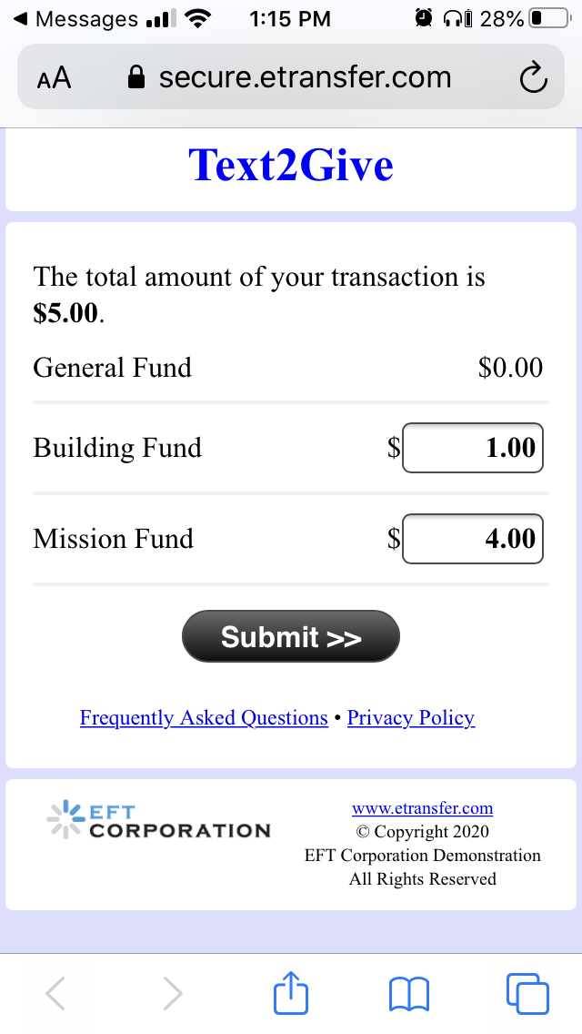
If you choose to designate your gift, you will have an opportunity to choose from a list of options.

Slide 16
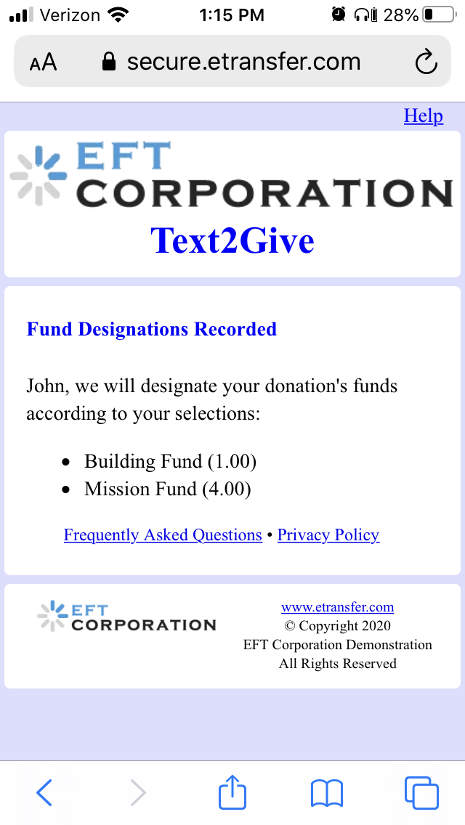
You will arrive at the fund designation confirmation screen.

Slide 17
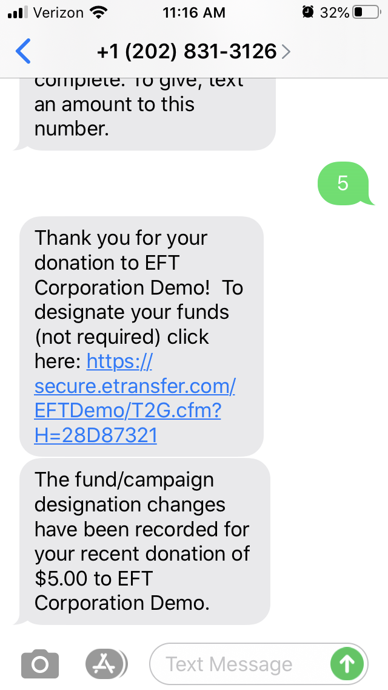
Your number here
You will also receive a confirmation text message.

Slide 18
Processing a refund

Slide 19
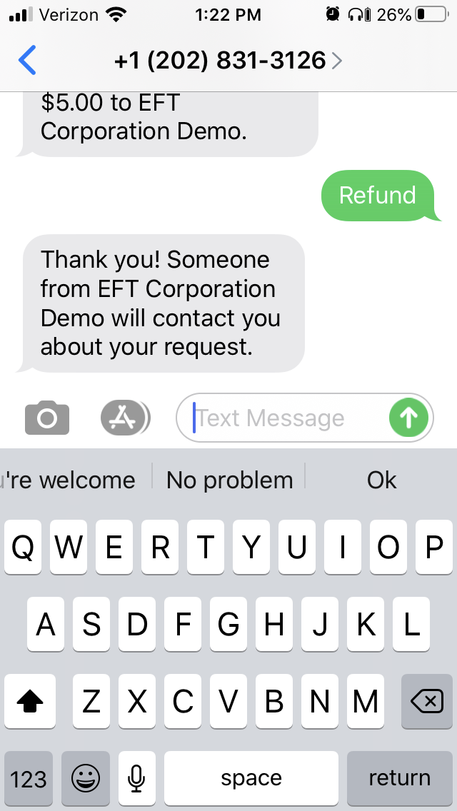
Your number here
If you have made an error in your amount, text “Refund” or “Void” to your church’s Text2Give number.
You will be contacted about the transaction or transactions you wish to refund.

Slide 20
Your refund will be processed within three (3) business days.

Slide 21
Updating your TEXT2gIVE rEGISTRATION

Slide 22
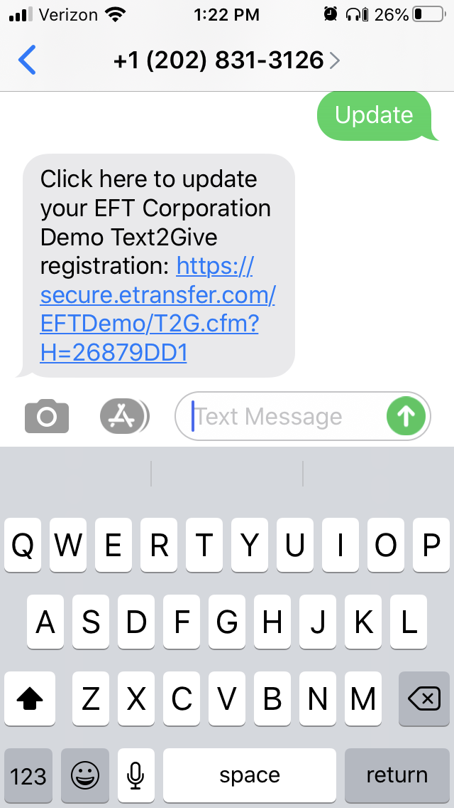
If you need to change any of your information, associated with your Text2Give registration, simply text “Update” to your church’s Text2Give number.
Click the link included in the response text message.
Your number here

Slide 23
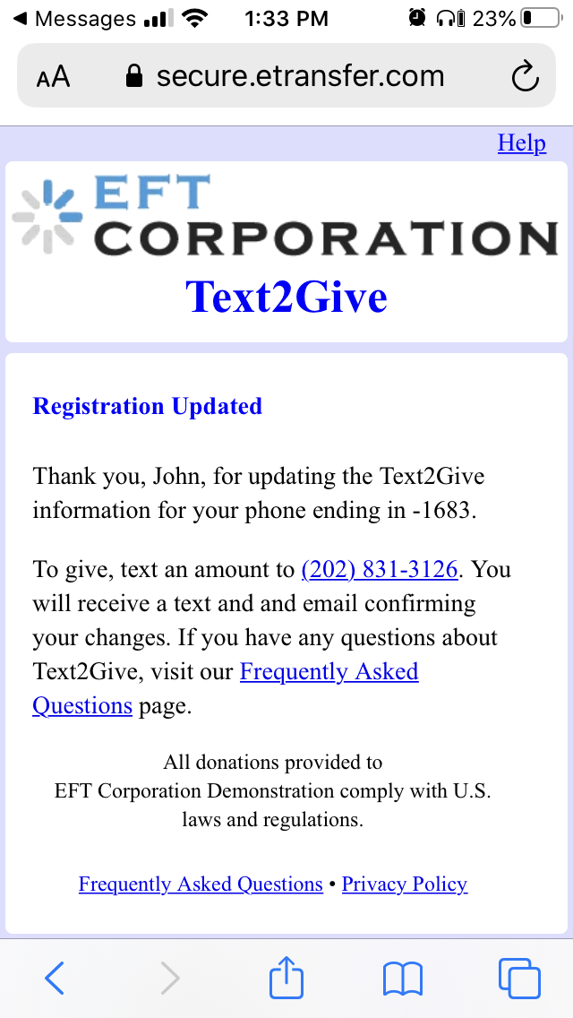
After editing your information, you will arrive at a confirmation screen.
Your number here

Slide 24
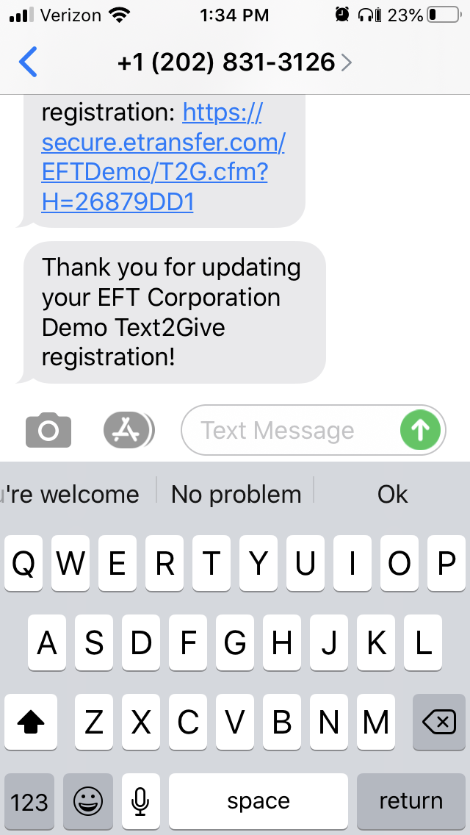
You will receive a confirmation email message regarding your update.
You will also receive a confirmation text message.
Your number here

Slide 25
If you have any questions please contact the church Office

